Slide 1
Leadership SUMMIT
June 6, 2023

Slide 2

GSNNJ New Staff members :
Chiquita Barnes Director of Community Engagement
Donna Anderson Executive Associate to the CEO & COO
Heavon Clark Community Engagement Program Manager

Slide 3
Dates To Remember
Tuesday, September 12 Leadership SUMMIT
Tuesday, November 14 Leadership SUMMIT

Slide 4
Key Messages
Product Program
Retail Sales
Business Integration
Troop Support
Membership Recruitment
Girl Experience Programs
Fund Development
Key Messages

Slide 5
2023 Girl Scout Cookie Program
Thank you for participating in the 2023 Girl Scout Cookie Program. We are excited to announce the winning troops of the “Bling My Booth” contest. Congratulations! Please refer to GSNNJ social media pages for pictures. Thank you to all troops that entered the contest!
Product Program
Troop Number | Service Unit | Troop Number | Service Unit
96810 | Pequannock | 98247 | Ramsey
97479 | Oakland | 98387 | Rockaway
97702 | Passaic Valley | 98543 | Wayne
98006 | Closer | 98614 | Randolph
98089 | Fair Lawn | 98638 | Parsippany
98147 | Ramsey | 98696 | High Point

Slide 6
Product Program

Slide 7


Retail Sales
GSNNJ Shop Hours
Paramus Shop Hours
Mondays through Fridays
9:00 a.m. to 12:00 p.m. & 1:00 p.m. to 5:00 p.m.
Tuesdays until 6:00 p.m.
Email the shop at: paramusshop@gsnnj.org
Randolph Shop Hours
Mondays through Fridays
9:00 a.m. to 12:00 p.m. & 1:00 p.m. to 5:00 p.m.
Tuesdays until 6:00 p.m.
Email the shop at: randolphshop@gsnnj.org
Riverdale Shop Hours
Mondays, Tuesdays, Thursdays & Fridays
9:00 a.m. to 12:00 p.m. & 1:00 p.m. to 5:00 p.m.
Tuesdays until 6:00 p.m.
Closed Wednesdays
Email the shop at: riverdaleshop@gsnnj.org
Council shops will be closed for Inventory July 17-28th
We will resume summer hours Monday July 31st.
Lockers now available at all three locations!
**Please visit www.gsnnj.org/shop for most current hours**

Slide 8

BRIDGING KITS
AVAILABLE
IN ALL THREE SHOPS
TO ORDER: EMAIL shop@gsnnj.org

Slide 9

GRADUATION
HONOR CORDS
AVAILABLE NOW
IN ALL THREE SHOPS
$17 EACH

Slide 10


Slide 11
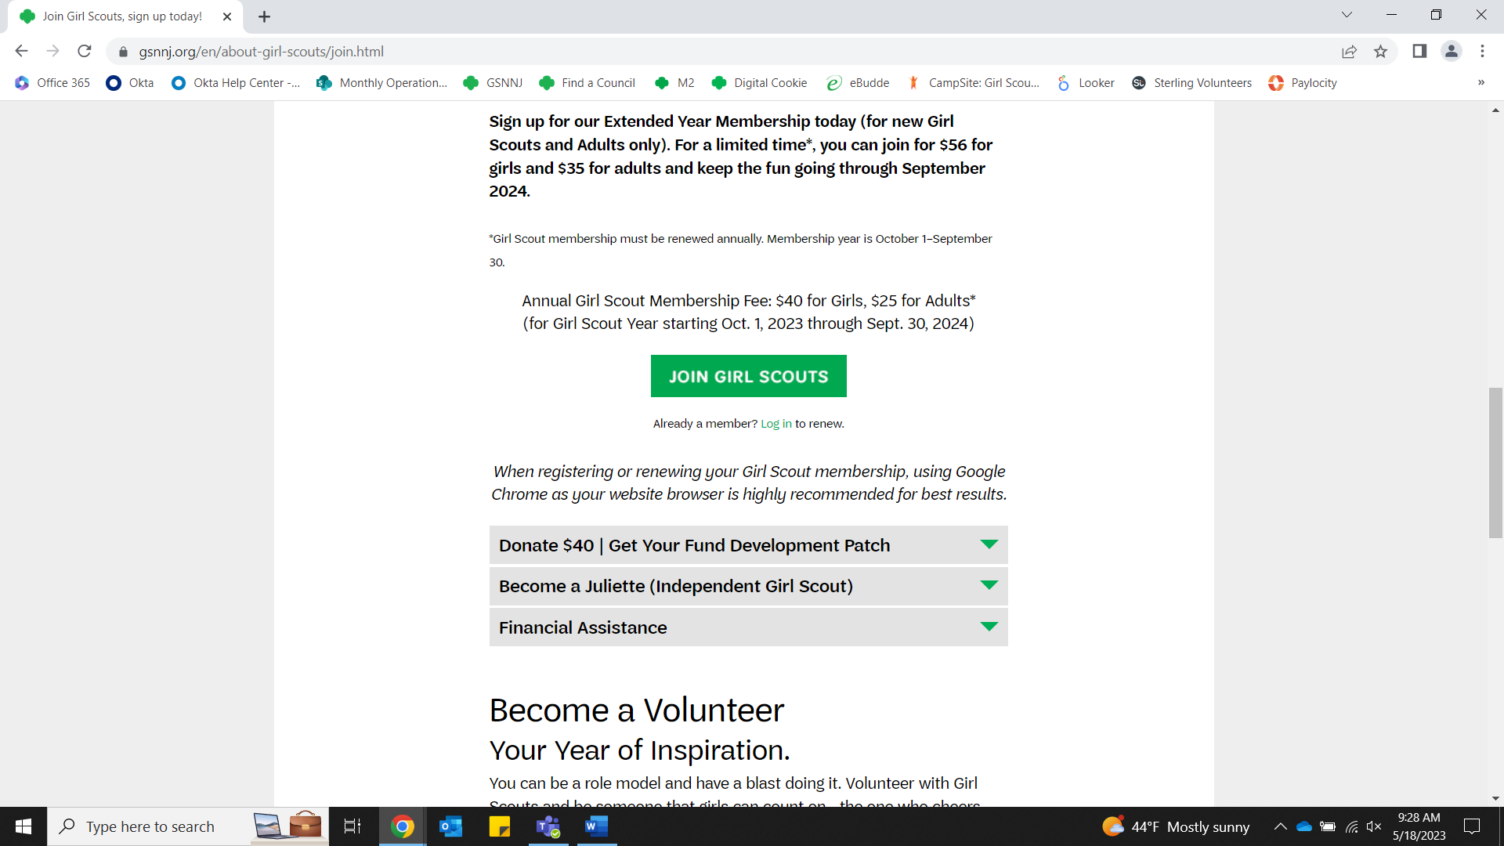
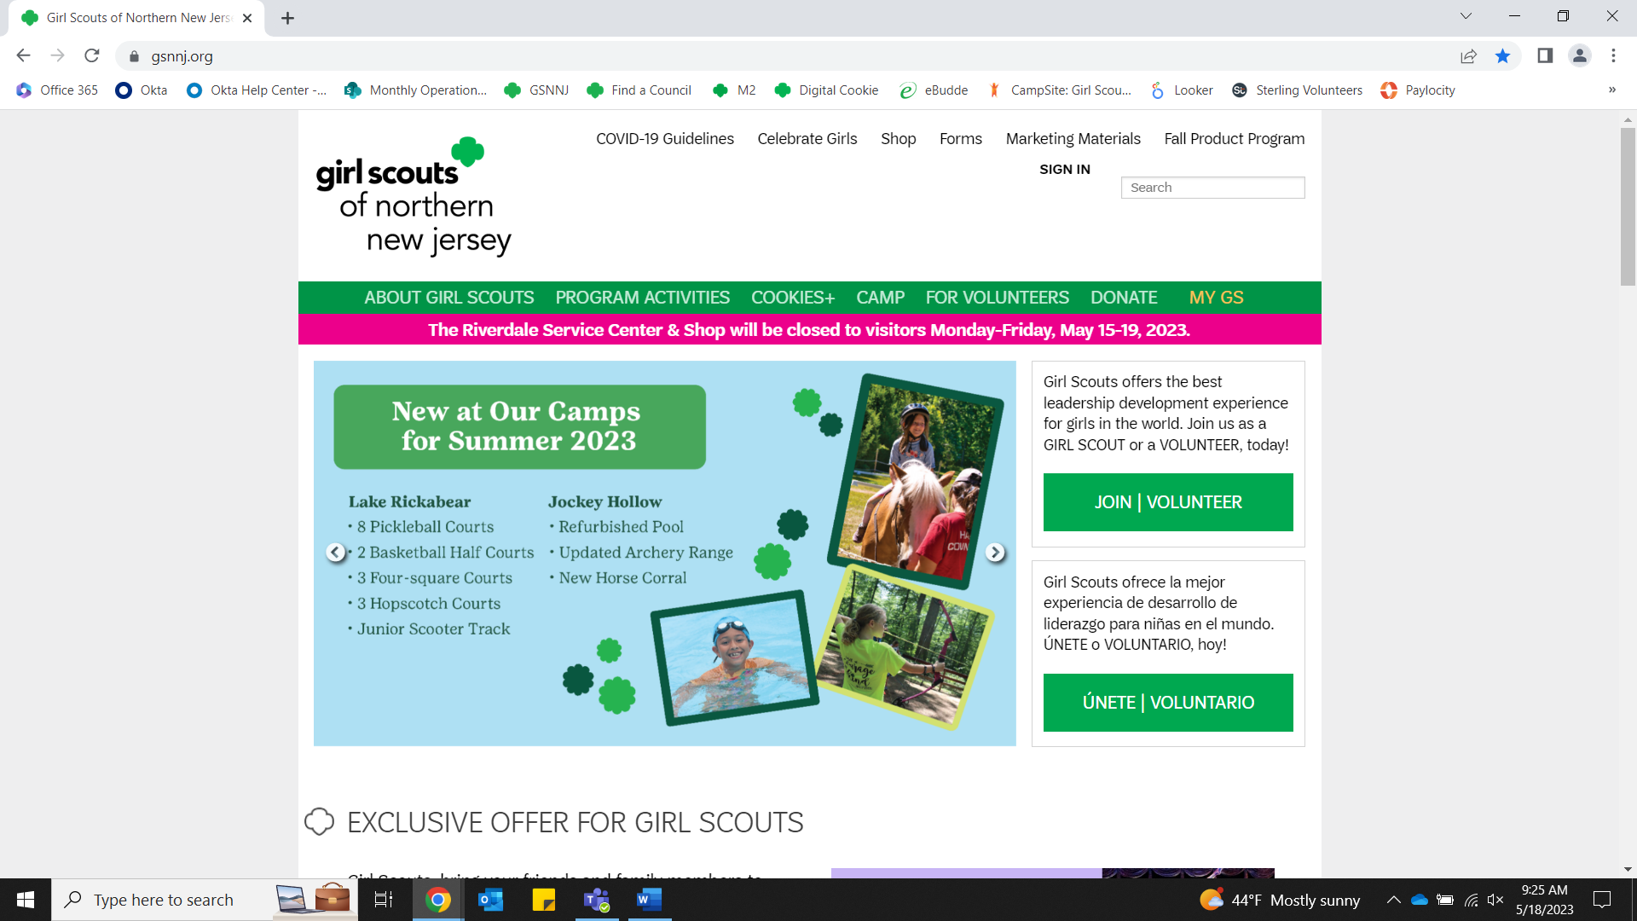
Business Integration
Go to gsnnj.org and Click Join/Volunteer
Click Join Girl Scouts

Slide 12
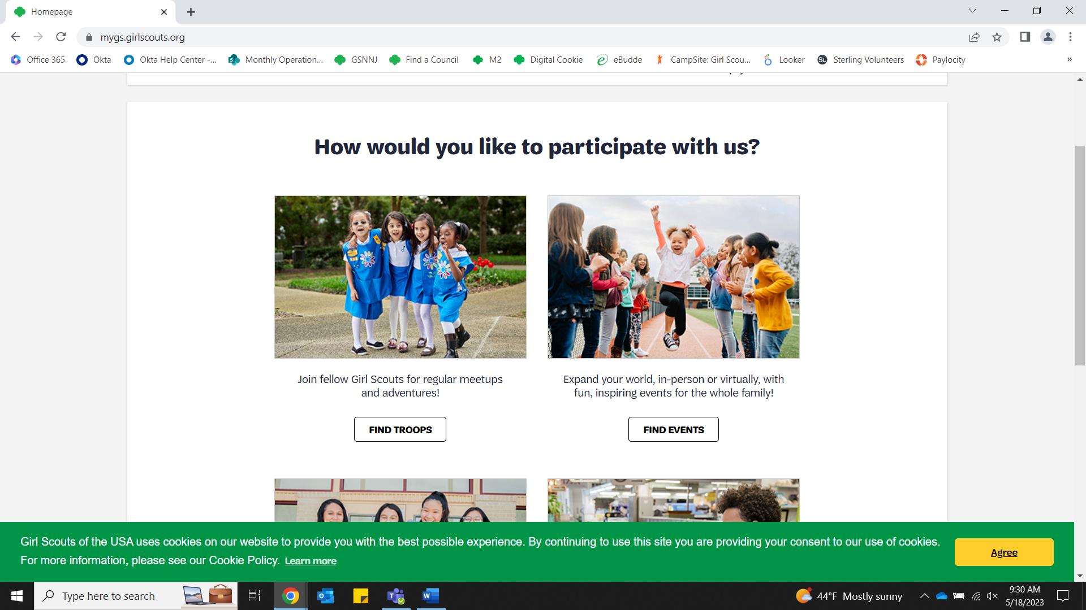
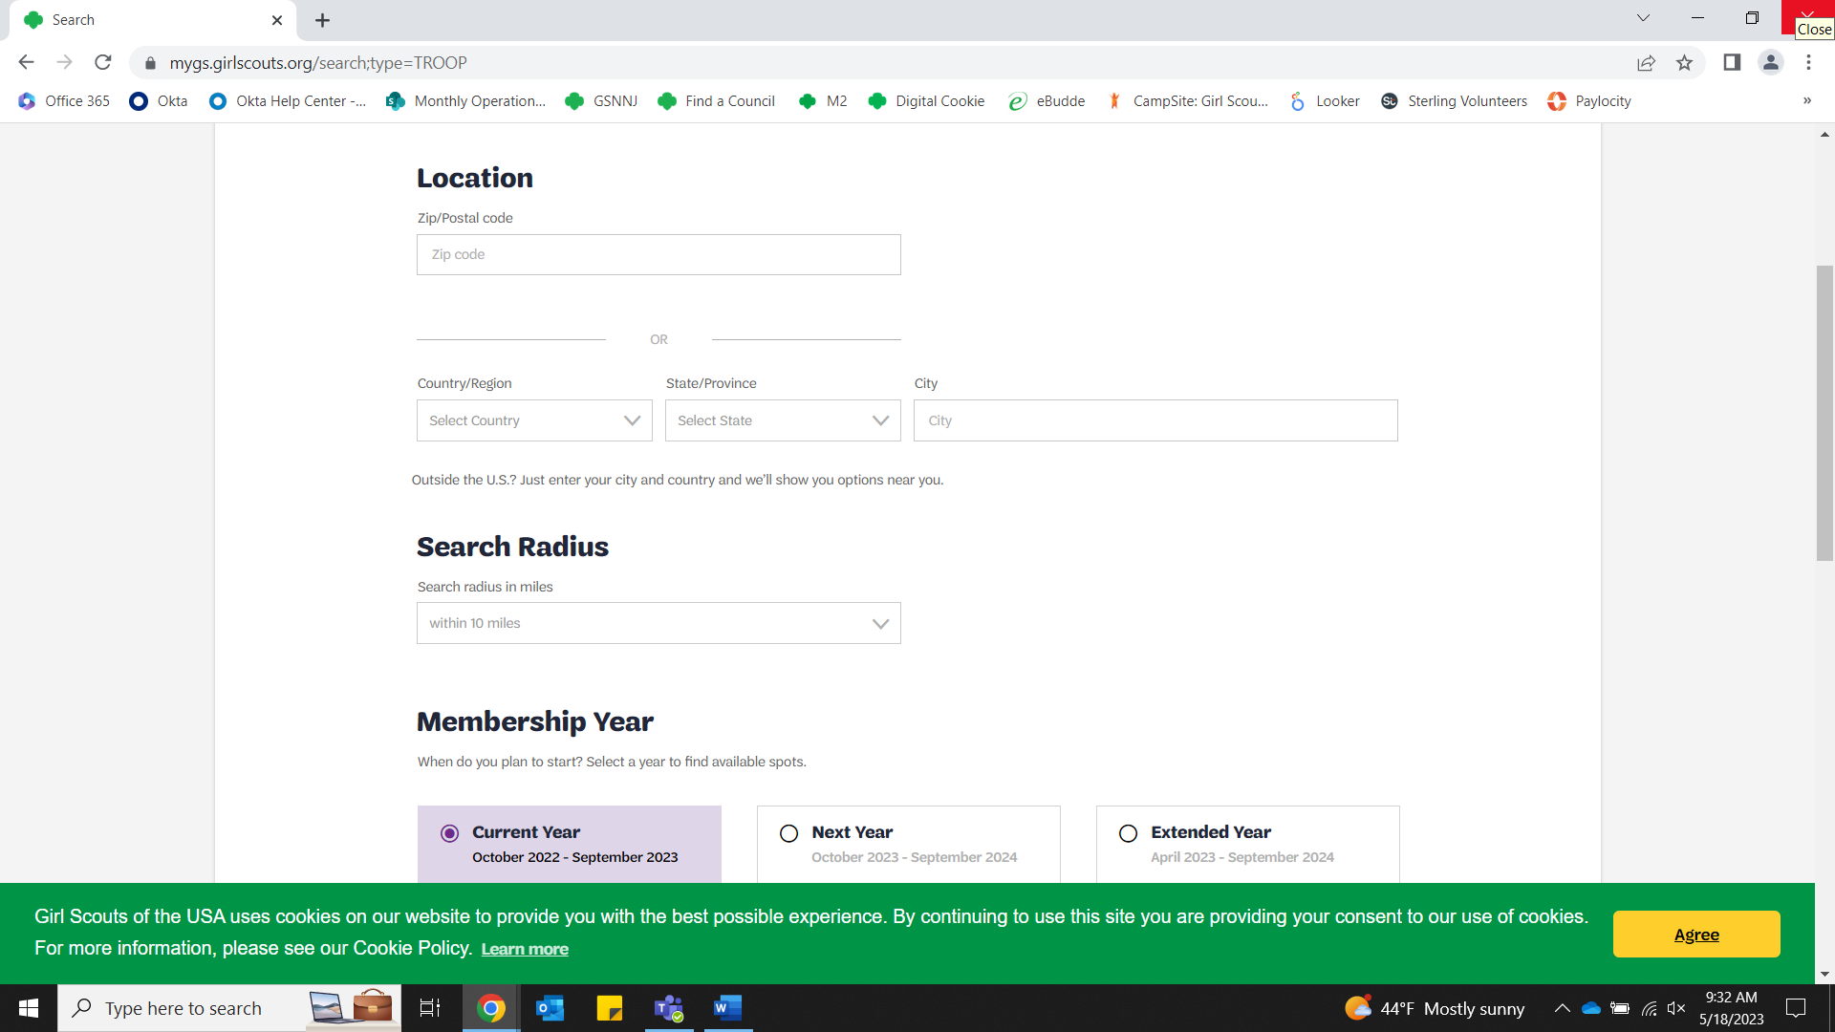
Business Integration
Click Find Troops
Enter zip code in “Location” field and select membership year you are registering for, scroll to the bottom and click “Search”

Slide 13
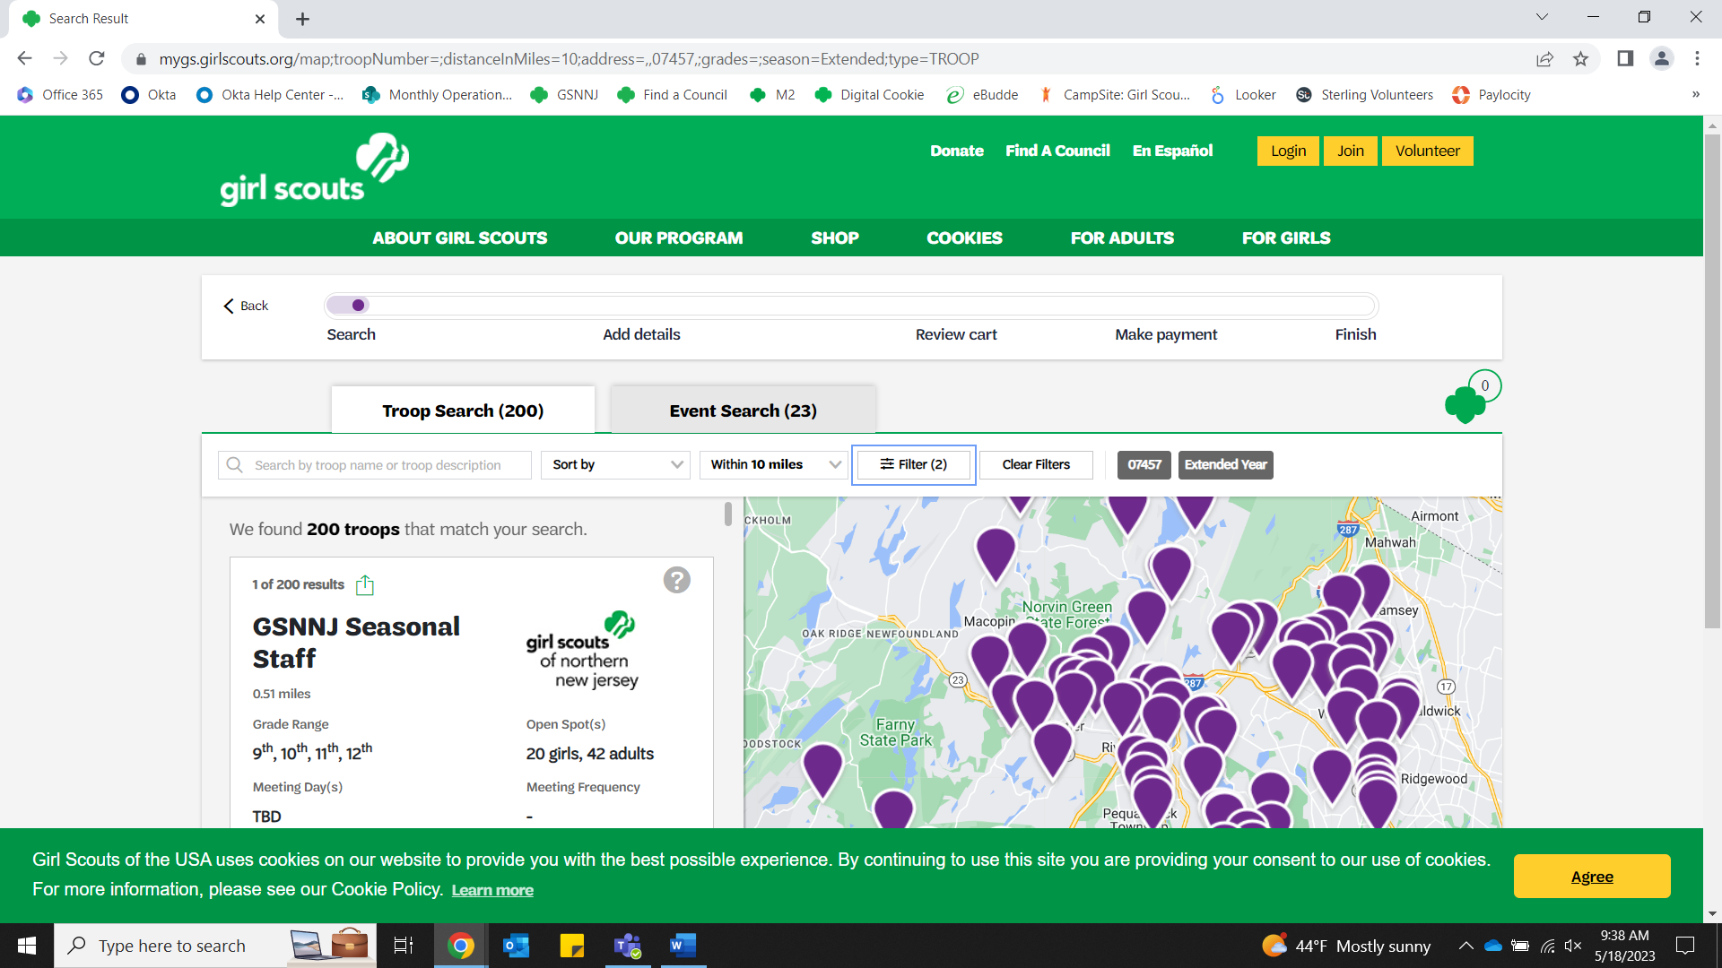
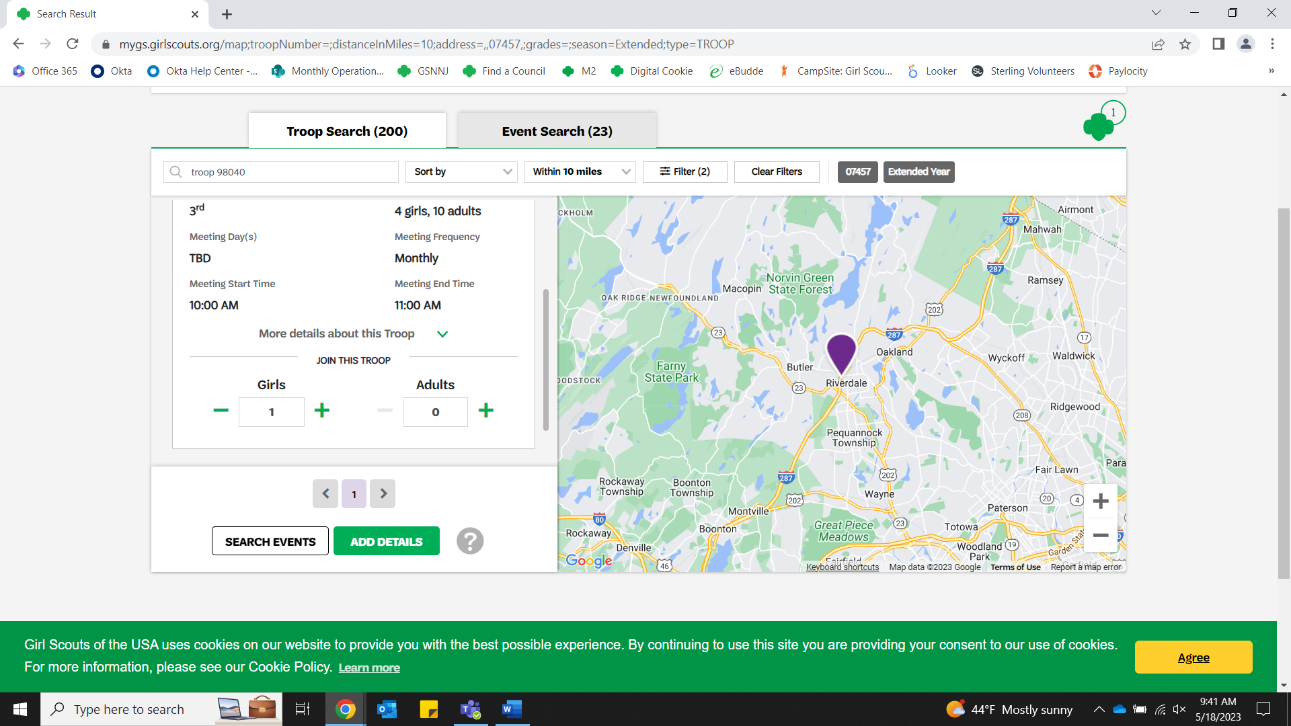
Business Integration
Enter the Troop Number or Recruitment Campaign (Troop Number MUST have the word “Troop” before it (ex. Troop 12345).
Click on the “+” next to “Girl” and “Adult” to add members to the Troop and click “Add Details”

Slide 14
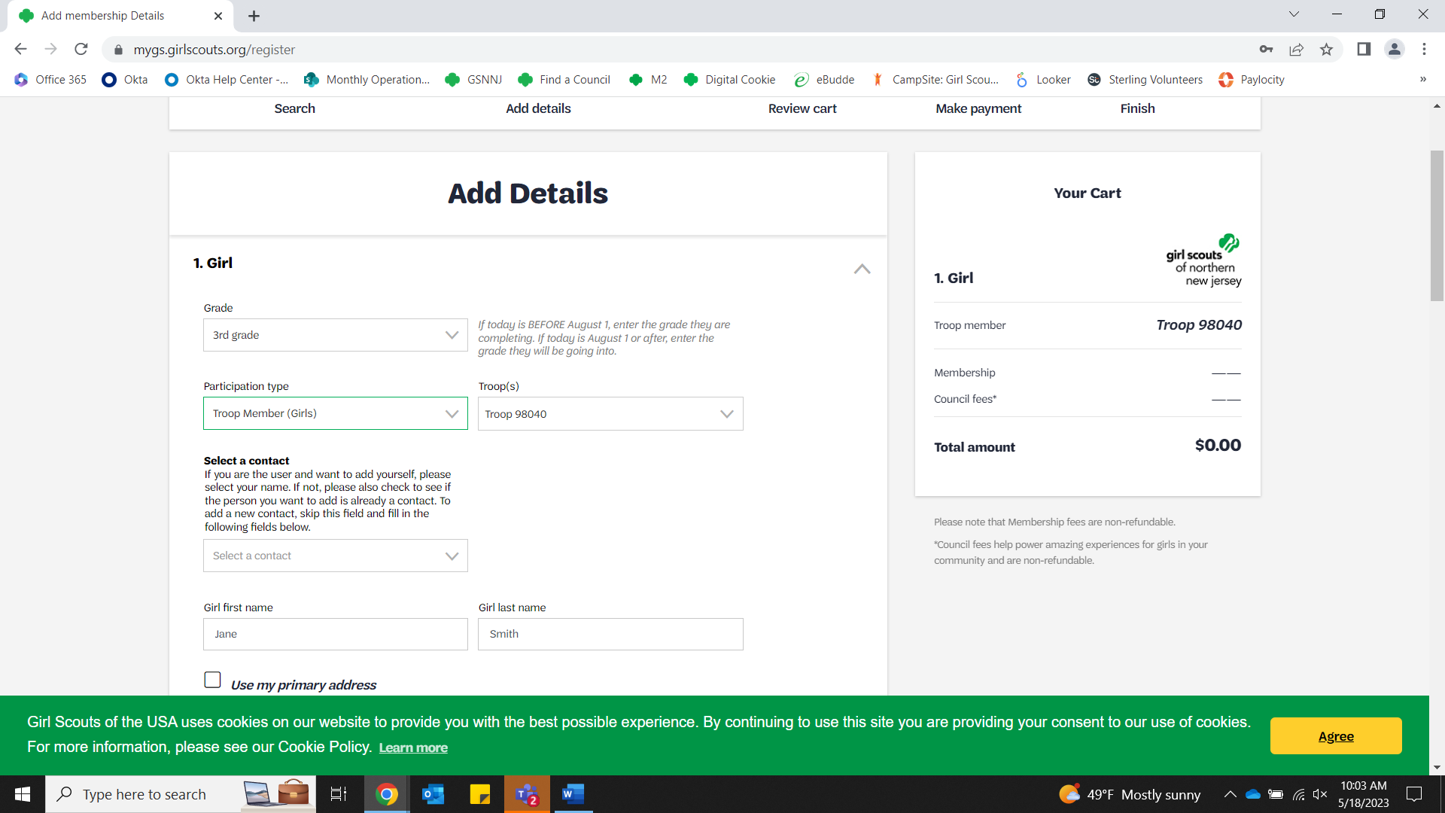
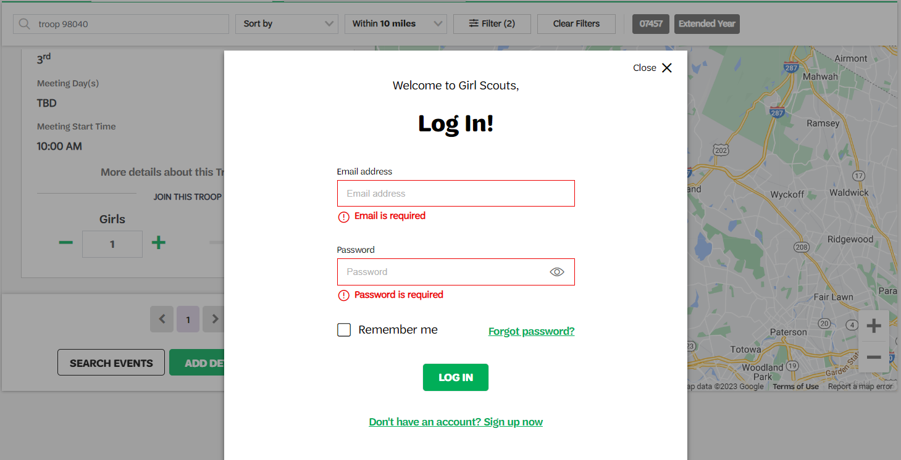
Business Integration
Log In to your current account. If you do not have an account, click on “Don’t have an Account? “Sign Up Now” and follow the prompts sent to your email to create an account.
Add details

Slide 15
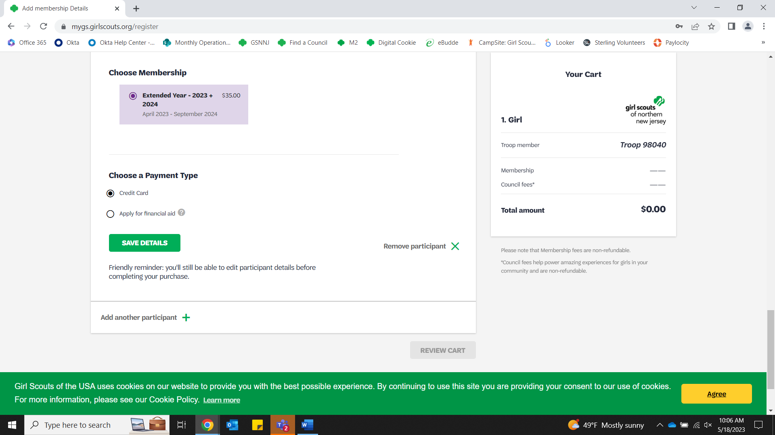
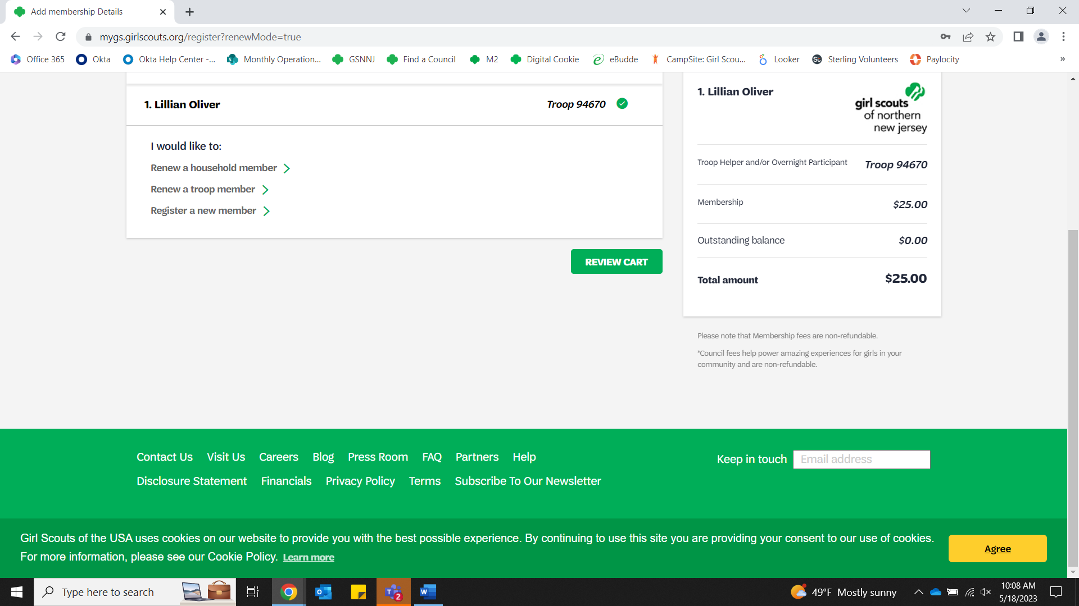
Business Integration
Select Membership and Payment Type and click “Save Details”
Click “Review Cart”

Slide 16
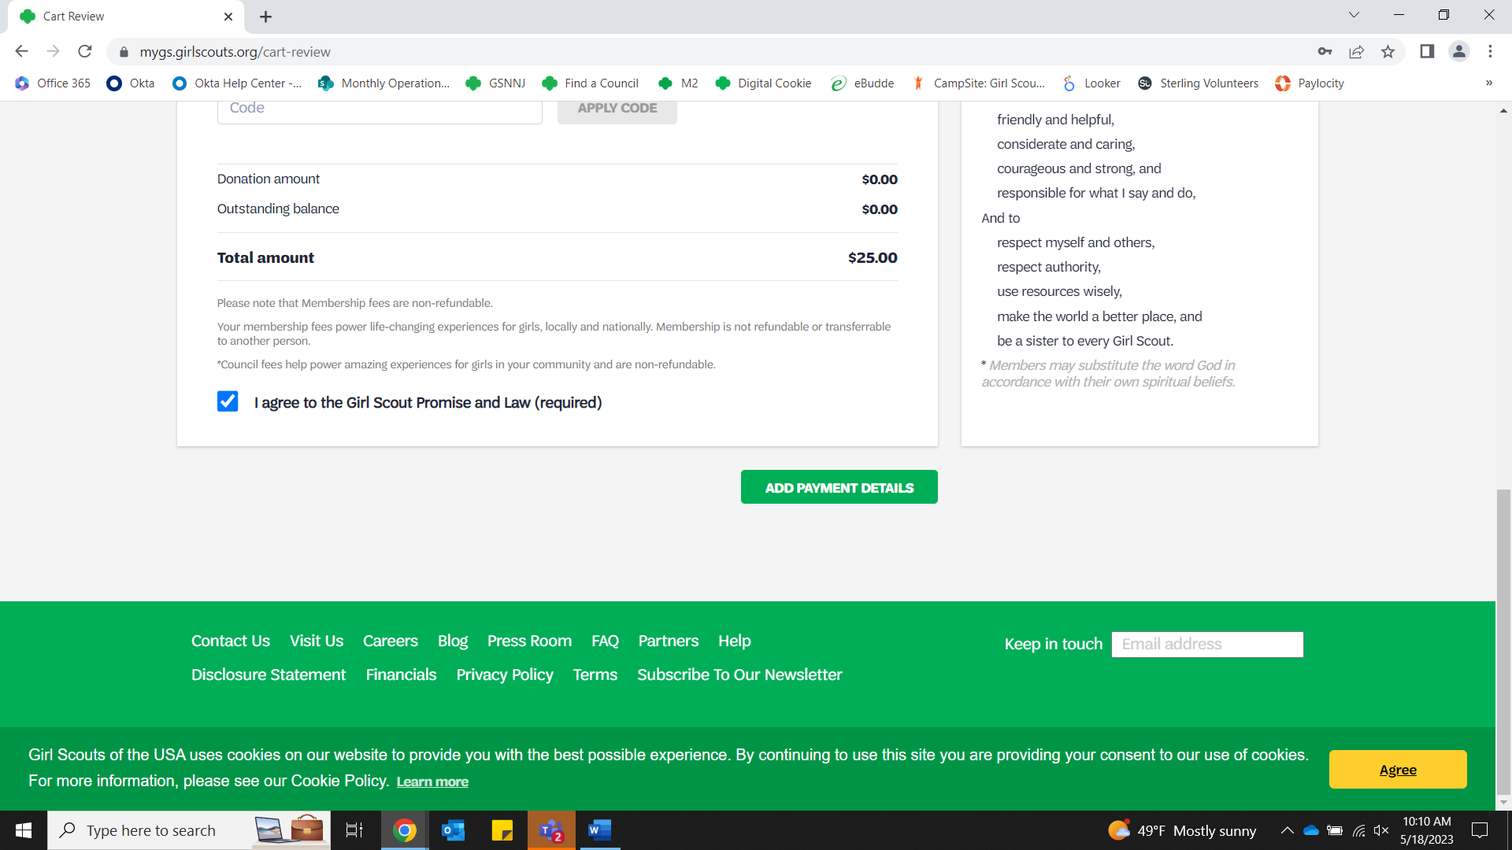
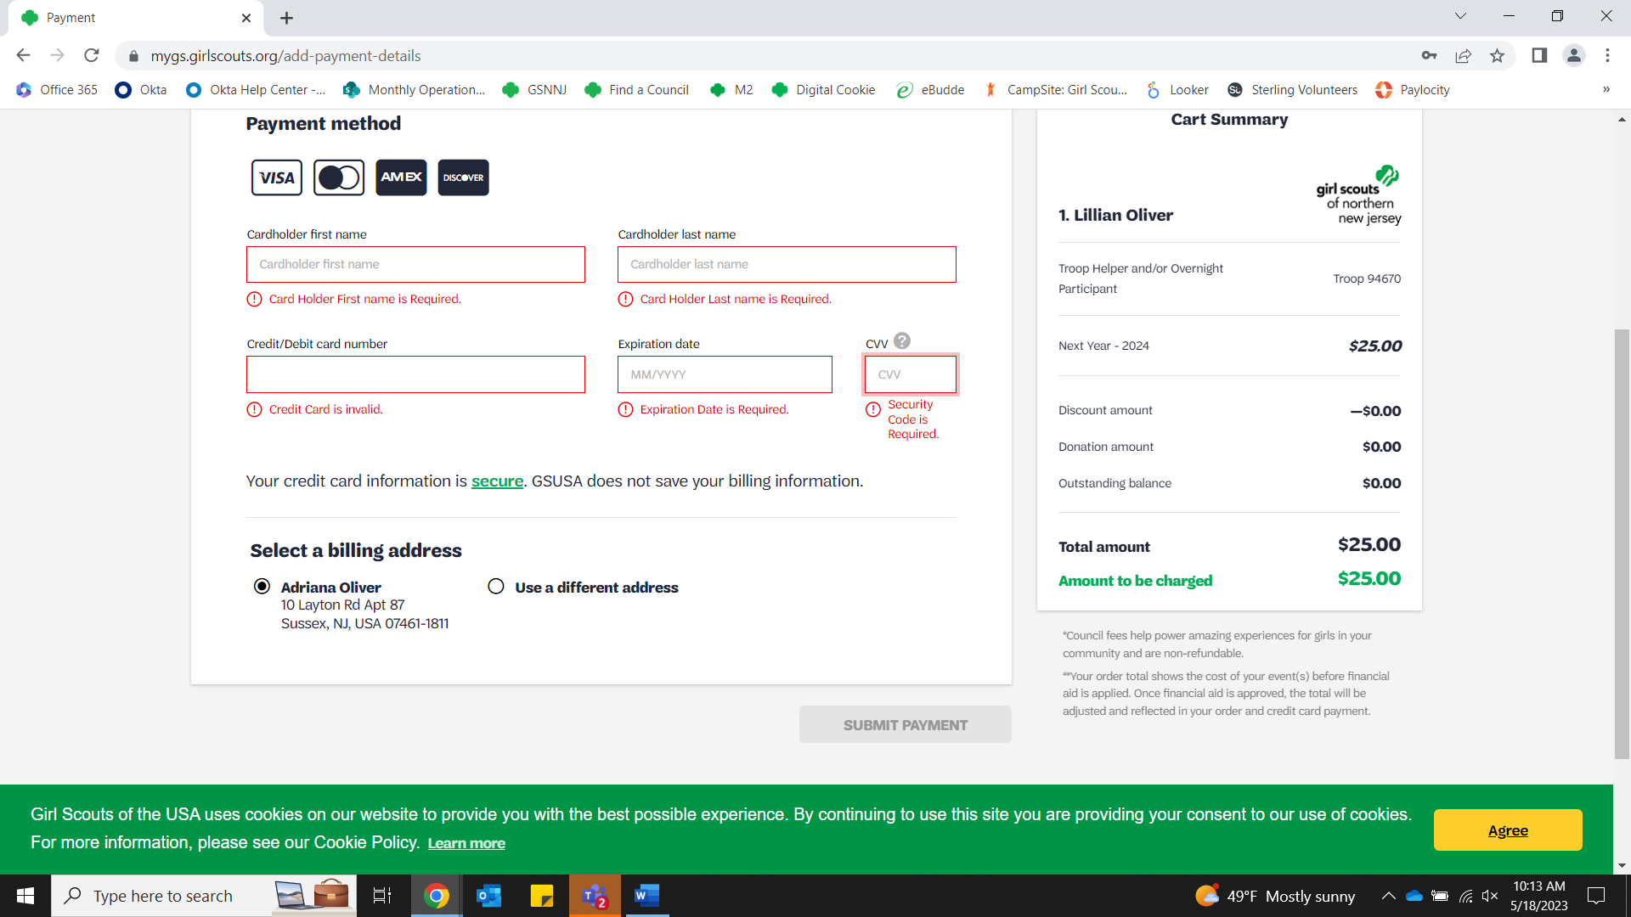
Business Integration
Check off “Agree to Promise and Law” and click “Add Payment Details”
Enter payment information and click “Submit Payment”

Slide 17
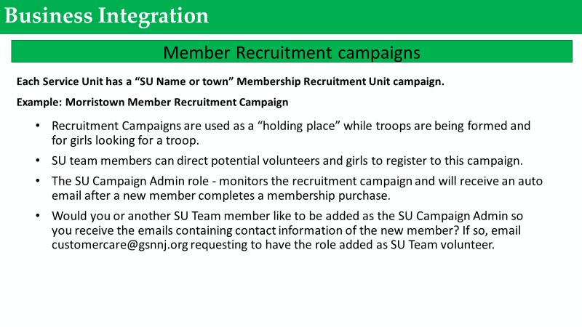

Slide 18
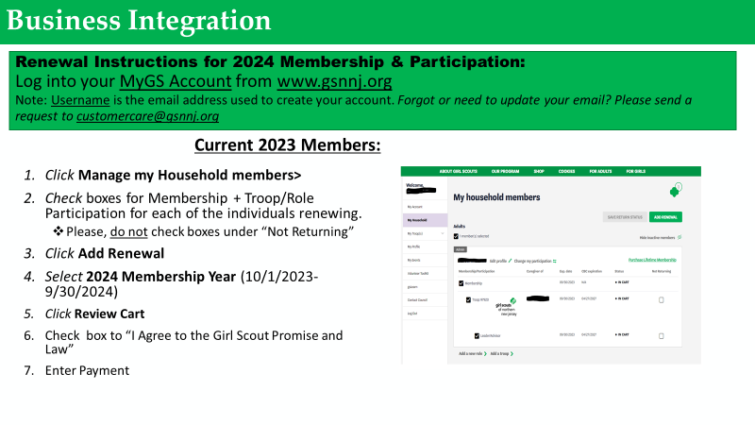

Slide 19
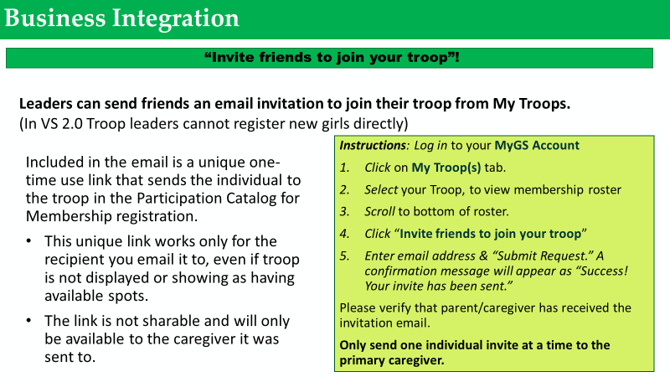

Slide 20
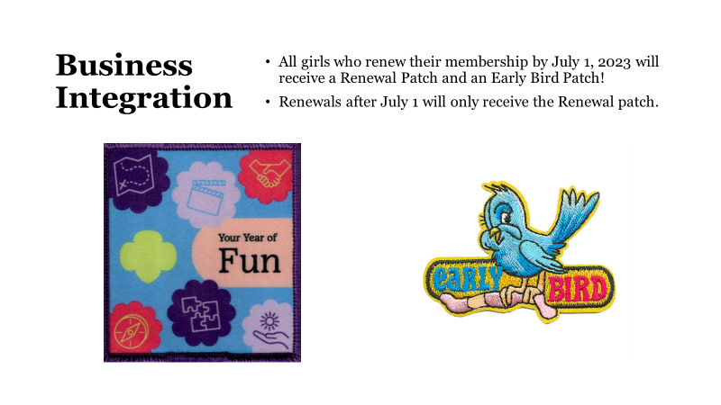
Business Integration

Slide 21


Slide 22
Business Integration
As of August 1, 2023, only Next Year – 2024 Membership will be available to purchase online.
If you have any programs or encampments taking place prior to October 1, 2023 and need to have girls or adults register for membership for 2023, please contact Customer Care at customercare@gsnnj.org for the purchase of MY 2023 or Extended Year Membership.

Slide 23
Troop Support
Troop and Service Unit Finance Reports
Troop Finance Reports
Will be due in July with a copy of the June 30th, 2023 bank statement
Additional information and instructions will be forwarded before June 30, 2023
Troop Finance Reports are completed in the Finance Tab of the VTK
Service Unit Finance Reports
The report form and additional information will be forwarded before June 30, 2023

Slide 24
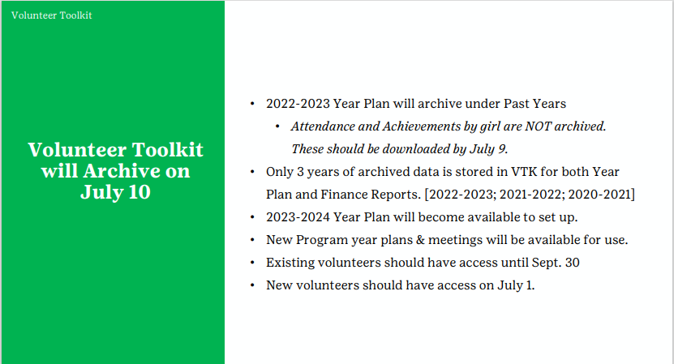
Troop Support

Slide 25
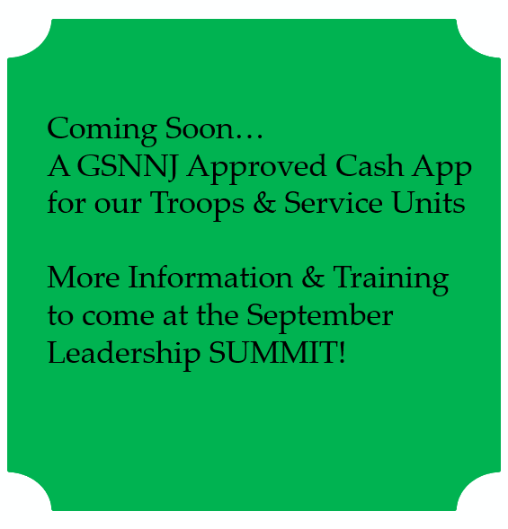

Troop Support
Daisy New Leader Orientation
June 8, 2023 at 6:30 pm Virtual
June 22, 2023 at 10:00 am In Person Riverdale Service Center
Brownies to Ambassadors
New Leader Orientation
June 13, 2023 at 6:30 pm Virtual

Slide 26

The following Service Units have reached 100% of
Girl Membership Goal:
Allendale
Carlstadt, East Rutherford
Chatham
Cliffside Park. Fairview
Closter, Demarest, Haworth
Cresskill
Denville
Dover
Dumont
East Hanover
Edgewater, Leonia
Elmwood Park
Emerson
Englewood
Fair Lawn
Franklin Lakes
Glen Rock
Goffle Brook ( Hawthorne, N. Haledon)
Hackensack, Maywood, Rochelle Park, South Hackensack
Hanover Township (Whippany, Cedar Knolls)
Harrington Park, Northvale, Norwood, Old Tappan, Rockleigh
Hasbrouck Heights/Teterboro
High Point (Augusta, Branchville, Frankford, Lafayette, Sussex, Wantage)
Ho Ho Kus
Hopatcong, Glasser
Kinnelon
Lincoln Park
Long Hill ( Gillette, Sterling, Millington)
Madison/Harding
Mendham (Borough, Township, Brookside)
Mine Hill
Montville (Pine Brook, Towaco)
Morris Plains
Mountain Lakes
New Milford
Paramus
Parsippany ( Lake Hiawatha, Mt. Tabor)
Passaic Valley
Pequannock (Pompton Plains)
Ramsey
Ridgewood
River Vale
Rutherford
Saddle Brook
Sparta
Vernon
Waldwick
Wanaque, Haskell
Westwood, Township of Washington
Wyckoff

Slide 27
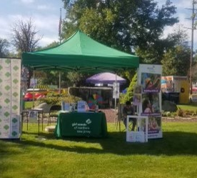
Membership Recruitment
Look for our
Summer Pop-Ups
to be held at
local parks, swim clubs,
recreation centers and at
townwide events.
27

Slide 28
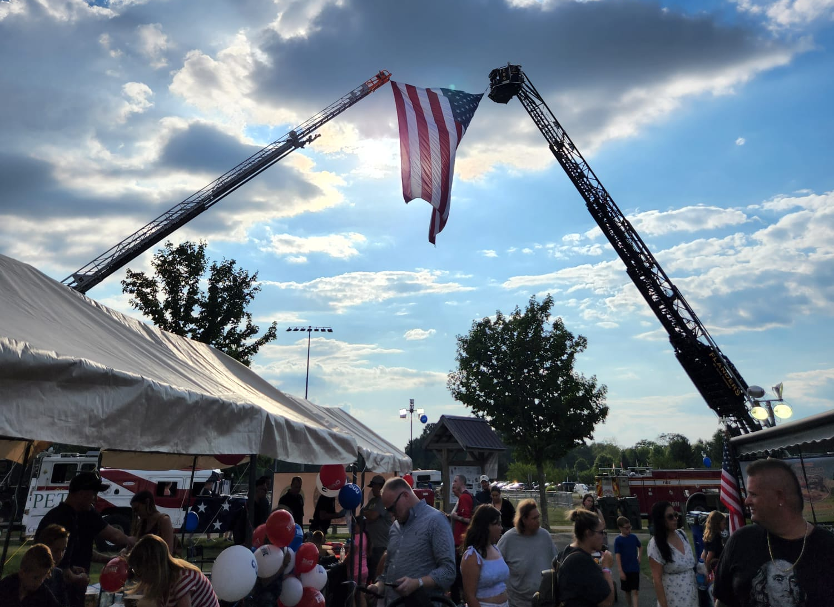
Membership Recruitment
NATIONAL NIGHT OUT
Tuesday, August 1, 2023
National Night Out is an annual community-building campaign that enhances the relationship between neighbors and law enforcement while bringing back a true sense of community.
Building great community connections!

Slide 29
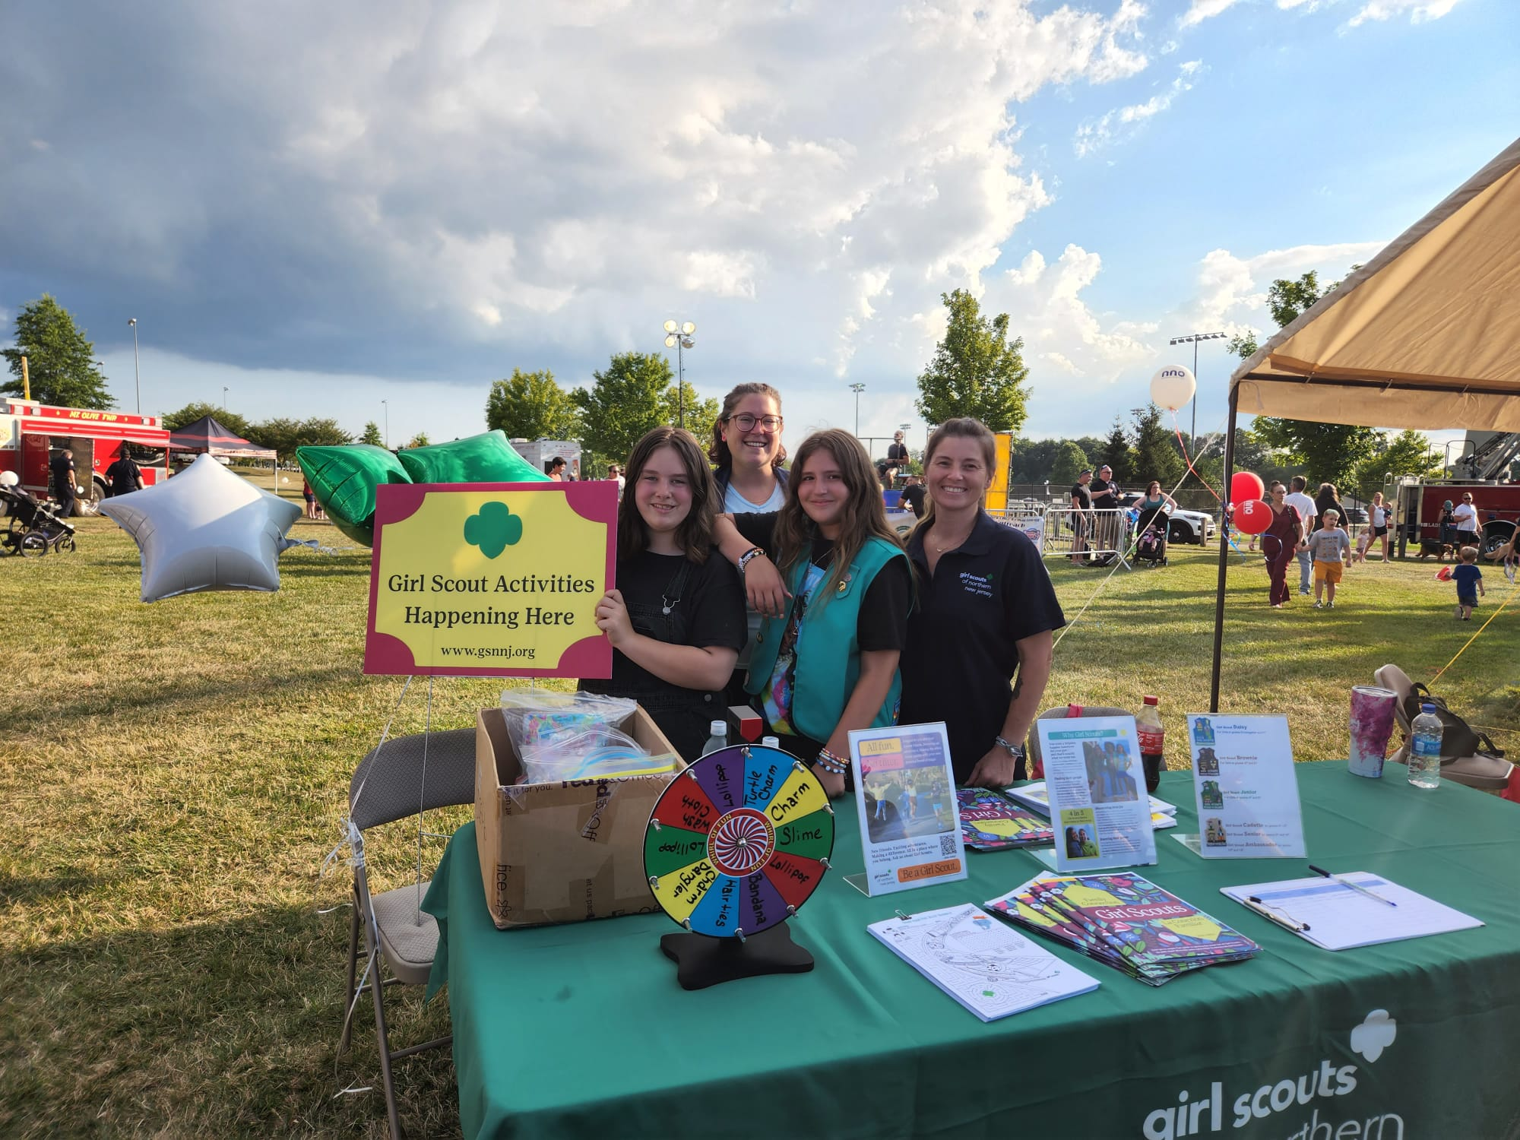
Membership Recruitment
Service Unit Recruitments and Townwide Events
Please let your Membership Recruitment Manager know if your Service Unit will be participating in community events so we can work together and provide you with supplies!
Editable flyers for 2023-24 will be available soon.

Slide 30

Membership Recruitment
Looking forward to a great 2024 Girl Scout year!
Kindergarten Registrations have begun!
Be on a lookout for some great events for incoming Kindergarteners.
If you need flyers or can assist us with the distribution, please let your Membership Recruitment Manager know.

Slide 31
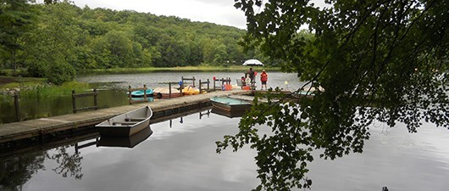

Membership Recruitment
MEMBERSHIP APPRECIATION PARTY
Renew your membership by July 1, 2023, for the 2023-2024 Girl Scout Year and be our guest at our Membership Appreciation Party at Lake Rickabear Camp in Kinnelon on Aug. 5, 2023.
Spend a fun day enjoying the camp property, games, giveaways, music, food, and festivities for FREE as our thank you.
All girls who renew their membership by July 1, 2023 will receive an early bird patch and a renewal patch.*
Service Unit Managers & Troop Leaders: The first two Service Units to have 85% of their troops registered by July 1, 2023, will receive a $250 Visa gift card.*
The first ten troops to have 85% of their troop members renew their membership by July 1, 2023, will receive a $50 Visa gift card for troop activities.*
(*All incentives will be available for pickup at our Membership Appreciation Party at Lake Rickabear on Aug. 5, 2023.)

Slide 32

Membership Recruitment
GREEN TABLE TALK FOR NEW LEADERS
For new leaders of the 2022-23 membership year
You are invited to our next virtual Green Table Talk session on Monday, June 12 from 6:30pm – 7:30pm
Maria Gonzalez, Troop Support Manager, will be our guest speaker.
Let’s talk about membership renewal, bridging if your troop is moving up to the next level, troop finances, and anything else you would like!
For new leaders with an Extended Year 2023-2024 membership:
You are invited to a virtual Green Table Talk session on Monday, June 26
from 6:30pm – 7:30pm
Come meet other new troop leaders and get your questions answered.
Let’s talk about recruiting girls and troop helpers for your troop, setting up a bank account, badge earning ideas
and more!
Contact Lissette Tufaro at ltufaro@gsnnj.org for Zoom link

Slide 33





Program
Be sure to check-out all our upcoming programs and share the fliers with troop leaders and families. You will receive the flyers along with this PowerPoint deck in an email this week.
Highest Awards Workshops – Please check-out the fliers for upcoming Bronze, Silver, and Gold Award Workshops Spring 2023 dates. For questions email Pat Christie at pchristie@gsnnj.org.

Slide 34

Program
Summer Camp 2023
Locations: Lake Rickabear, Kinnelon, NJ
Jockey Hollow, Mendham, NJ
Weekly Sessions: July 5-Aug. 18
For: Registration for Summer Camp is now open for girls entering Grades 1-11 in fall 2023.
Registration is open NOW!
Campers can sign up for one or more weeks.
Two-week CIT program for 9th-11th graders
Horsemanship programs
Badge programs
Daily instructional and free swim
Zip line, challenge course, archery, arts & crafts, nature, stream exploration and more.
Learn more at www.gsnnj.org/camp. For more information: Lake Rickabear contact Dara Garcia at dgarcia@gsnnj.org. Jockey Hollow contact Shannon Cornine at scornine@gsnnj.org.

Slide 35
Lifeguard Certification
Location: Lake Rickabear, Kinnelon, NJ
Dates & Times:
Sat., June 10, Sun., June 11, 2023, at 9:00 a.m. – 5:00 p.m. & Mon., June 12, 2023, at 5:00 p.m. – 10:00 p.m.
Sat., June 17, Sun., June 18, 2023, at 9:00 a.m. – 5:00 p.m. & Thu., June 29, 2023, at 5:00 pm – 10:00 p.m.
(Note: you must attend the 3 dates to receive certification)
New Lifeguard Waterfront certification with waterfront: $450
New Lifeguard certification Waterfront with waterfront for staff: $300
The link to apply is here: https://blueoceanaquaticsny.com/american-red-cross-lifeguard-with-waterfront/
Lifeguard recertification with Waterfront: $250
Lifeguard recertification with Waterfront for staff: $200
The link to apply for the recert is: https://blueoceanaquaticsny.com/american-red-cross-lifeguard-with-waterfront-review/
Lifeguards protect their community by preventing, recognizing, and responding to water-related emergencies. To get a job at most facilities, you need to become certified, and most employers look for American Red Cross Certification. Obtain your 2-year ARC certification by taking our Lifeguarding/Waterfront course at Lake Rickabear Day Camp! This comprehensive course takes 33 hours (including the 7-hour online component) and emphasizes hands-on training, supported by classroom instruction. For more information and registration contact: Blue Ocean Aquatics, blueoceanaquaticsny@gmail.com or call (631) 835-7017

Slide 36

Program
Birthplace Bound
For: Girl Scout Cadettes-Ambassadors
Location: Savannah, GA
Date: Tue., Nov. 7 to Sun., Nov. 12, 2023
Fee: $975 per person – 4 to a room
$1275 per person – 2 to a room
REGISTRATION CLOSES JULY 1, 2023
Travel by train to Savannah, Georgia, the birthplace of Juliette Gordon Low, founder of the Girl Scouts. Discover what her life was like in the 1880s as we tour historic Savannah and participate in workshops at Juliette Gordon Low Birthplace and Girl Scout First Headquarters. Board a boat and search for dolphins and take a ghost tour at night. We'll dine at Mrs. Wilkes Boarding House and enjoy ice cream by the river. Registration opened March 9, 2023, when the first payment was due. The second payment is due on May 1, 2023, and the balance is due on July 1, 2023. Fee includes travel, hotel, tours, four (4) dinners, and four (4) breakfasts. Hotel is based on four people to a room. Participants must attend a preparatory meeting on Sept. 29, 2023, at 7:00 p.m. at the Riverdale Service Center. The last roster changes or withdrawal date is July 1, 2023. Refunds cannot be given after July 1, 2023. For more information email Lorena Kirschner at lkirschner@gsnnj.org.

Slide 37

Program
Wizarding School
For: Girl Scout Brownies-Juniors
Location: Glen Spey, NY
Dates: Fri., Oct. 6 – Sun. Oct. 8, 2023
Time: 7:00 PM-11:00 AM
Fee: $95 per girl/$65 per adult
Spend a weekend at Wizarding School at our Camp Glen Spey. Enroll and take classes in potions, herbology, defense, care of magical beings, and more. Visit a wand workshop and see what the local village has in store for you! Students and chaperones will stay overnight in troop houses or our new smaller cabins. Fee includes program supplies, lodging, meals, Wizarding School Patch and capes! LINK patch can be purchased at the council shops. Troops must register two leaders with current background checks. For more information email Lorena Kirschner at lkirschner@gsnnj.org.
Ordinary Wizarding Exams
For: Girl Scout Cadettes
Location: Glen Spey, NY
Dates: Sat., Oct. 21 – Sun. Oct. 22, 2023
Time: 9:00 AM
Fee: $107 per girl/$80 per adult
For those of you who believe your acceptance letter maybe lost in the mail, this weekend will have you enrolled in wizarding school and prepare you for your O.W.L.s! Our Cadette weekend will have you at potions, wands and learning defense against the dark arts. Spend the night at our Camp in Glen Spey, NY and see firsthand what stargazing over our private lake looks like. This October event is sure to fill your wizarding dreams. Please adhere to safety activity checkpoints for ratios. Independently registered girls welcomed. All food, lodging, activities, and instructions provided. For more information email Lorena Kirschner at lkirschner@gsnnj.org.

Slide 38
Program
Program on the Go
Are you looking for a mid-week program for your troop? Do our Program Activities conflict with your schedule? Consider setting up a Program on the Go. You may set it up at one of our 3 service centers or provide a location that works best for you. To learn more and complete our Program on the Go Interest Form visit https://www.gsnnj.org/en/events/programs-on-the-go.html.
For more information email Laura Ammaturo at lammaturo@gsnnj.org.
Here is a list of our most popular Program on the Go Activities:
Cake Decorating – girls will work with bakery icing and learn piping techniques.
Crochet 101 – using only a crochet hook and yarn, girls will learn the basic stitches to create a headband or flower.
Jewelry 101 – girls will learn to use jewelry pliers to transform wire, glass, metal, and shell beads into beaded earrings.
Sewing – girls will learn to use computerized sewing machines as they create sewing projects.
Plein Air Watercolor – girls discover architecture and native plants and trees as they sketch and paint outdoors.
Star Lab – GSNNJ brings the stars down to Earth, where girls will study the constellations and other wonders of the night sky.

Slide 39

Fund Development
Thank you for your support!

Slide 40

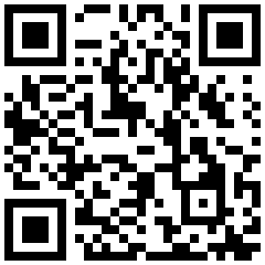
Campership Appeal
Fund Development
Campership financial assistance requests have DOUBLED this year!
Please scan the QR code to donate today!

